Slide 1
ARTIFICIAL INTELLIGENCE PROJECT WORK
PREDICT THE ELECTRICAL POWER OUT FROM COMBINED CYCLE POWER PLANT BY USING IBM WATSON

Slide 2
#MY TEAMMATES#
NAMES | ROLL NO
YASASWINI | 18481A12A1
MANEESHA | 18481A12A0
J D N SAI CHARAN | 19485A1213
SANDEEP READY | 18481A1257

Slide 3
INTRODUCTION
The gas turbine one of the most efficient one for the
conversion of gas fuels to mechanical power or electricity.
Combined cycle power plants are frequently used for
power production.
These days prediction of power plant output based on
operating parameters is a major concern and power plant
influenced by four main parameters.
Which are used as input variables in the data set, such as
ambient temperature, atmospheric pressure, relative
humidity and exhaust steam pressure.

Slide 4
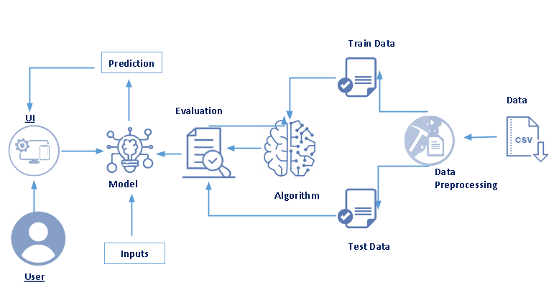
Architecture:

Slide 5
WORKING PROCEDURE :
First of all we have to understand the data.
And we required the data for doing project.
We have know the fundamental concept and
work on Anaconda.
And working with data set.
Dataset provided by IBM which available at the
UCI Machine Learning repository we using
00294 data set.
https://archive.ics.uci.edu/ml/machine-learning-databases/00294/
.

Slide 6
Data Visualization:
Data visualization is where a given data set is presented
in a graphical format. It helps the detection of patterns,
trends and correlations that might go undetected in text-
based data.
visualize the dataset we need libraries called Matplotlib
and Seaborn.
The Matplotlib library is a Python 2D plotting library which
allows
you to generate plots, scatter plots, histograms, bar
charts etc ..
DASH BOARD CREATION
EXPORT THE PROJECT FILES GITHUB

Slide 7


WORKING WITH DATA SET
DATA VISULIZATION CHARTS
Plotting scatter plot to summarize "AI" and "PE" data.
Plotting scatter plot to summarize "V" and "PE" data.

Slide 8


Plotting scatter plot to summarize "AP" and "PE" data.
Plotting scatter plot to summarize "RH" and "PE" data.
These many steps we have to follow in our project……..

Slide 9
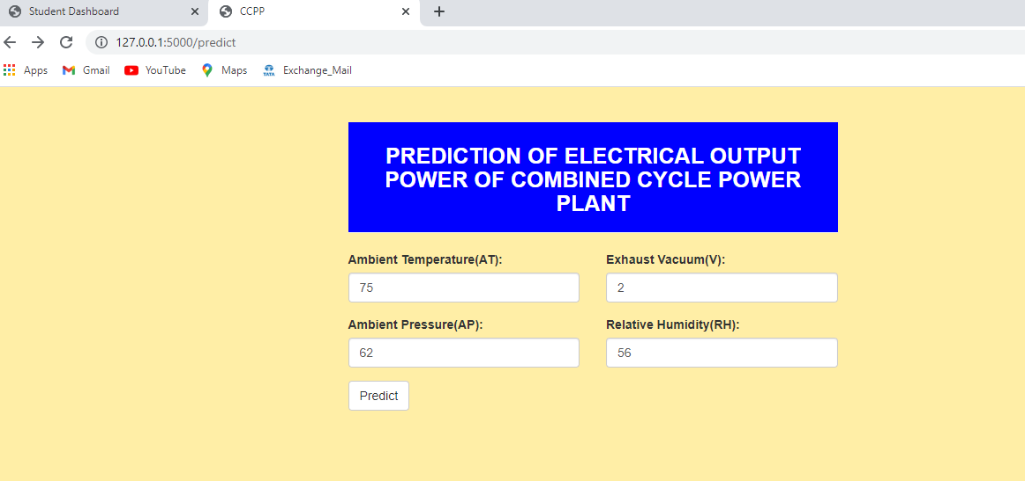
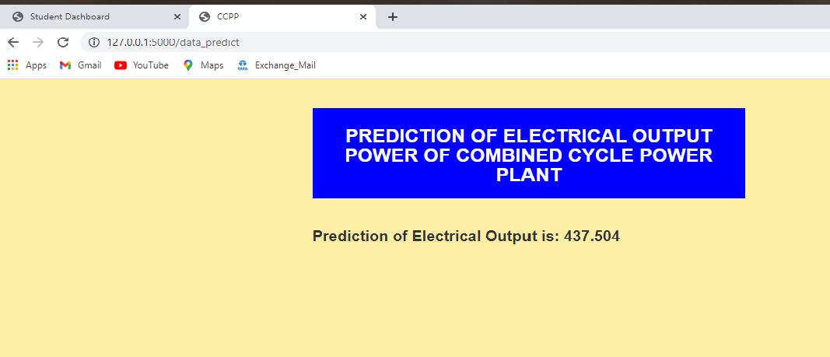
GIVING INPUTS:
PREDECTING THE RESULT FOR GIVEN INPUTS:

Slide 10
CONCLUSION:
At the beginning of this article, we set out to develop a predictive model for full-load output power (PE) based on the dataset provided.
We were able to discover that using a complete set of parameters or features on the Random Forest Regression algorithm yielded the best results.

Slide 11


